Slide 1
Learning Graph Neural Networks with Deep Graph Library
Lingfan Yu & Da Zheng & Quan Gan
with DGL Team
http://dgl.ai

Slide 2
Today’s schedule
Introduction to graph representation learning (30 mins)
Deep Graph Library 101 (1 hour 30 mins)
Scale GNN to large graphs (1 hour)
GNN-based recommender system (1 hour)

Slide 3
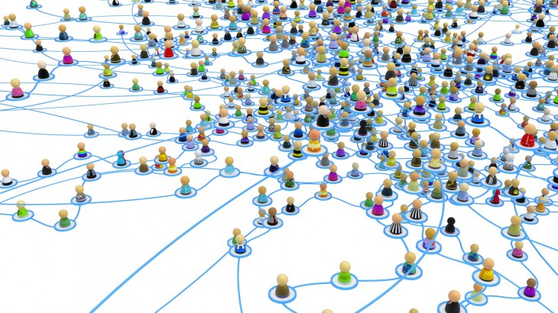
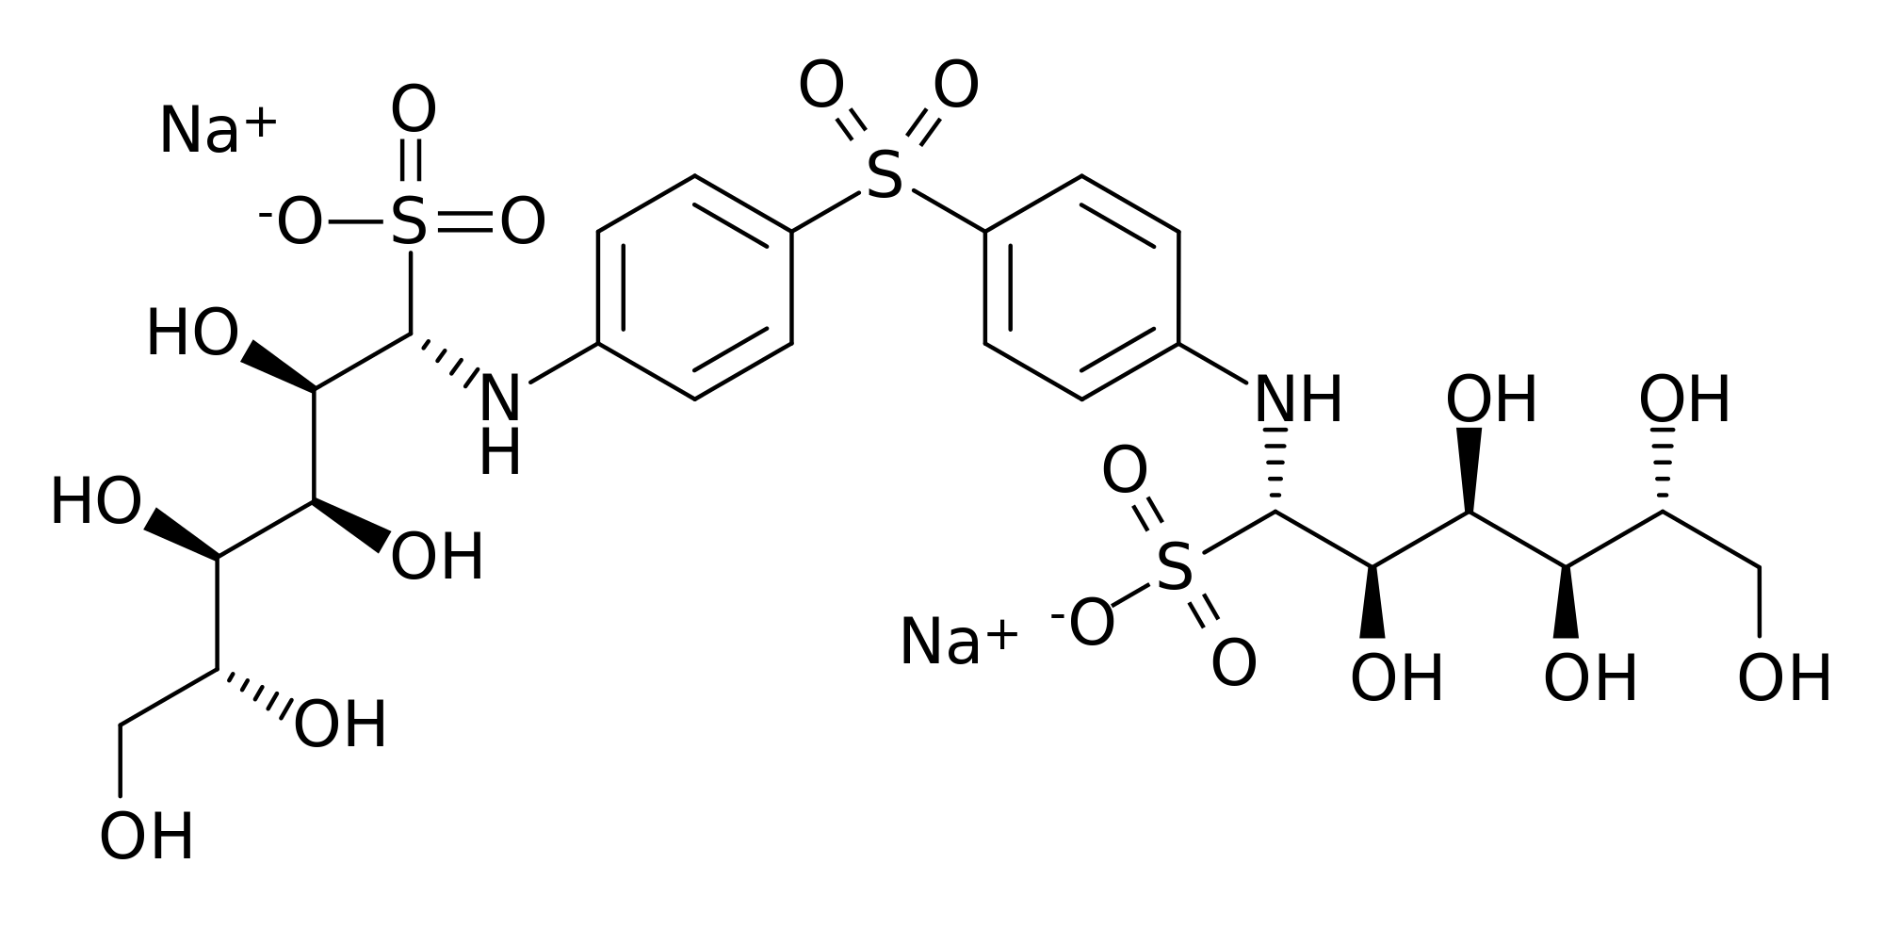
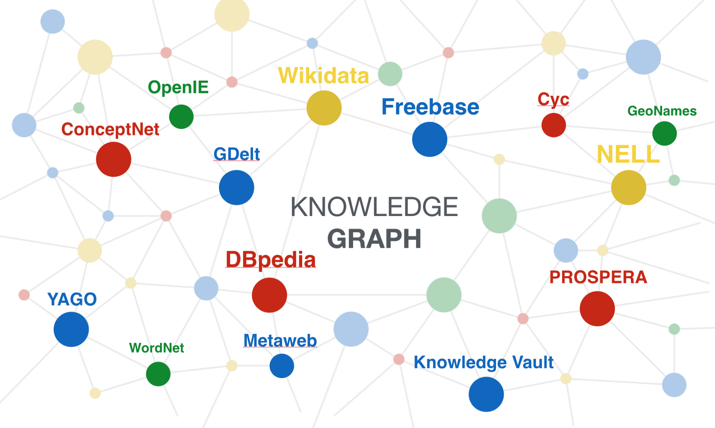
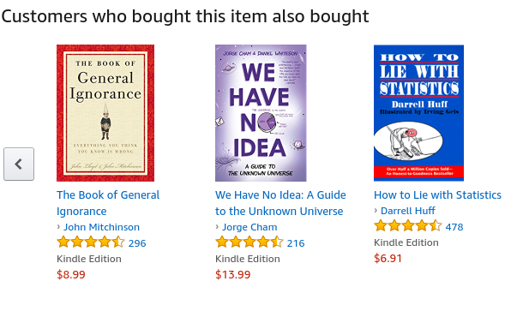
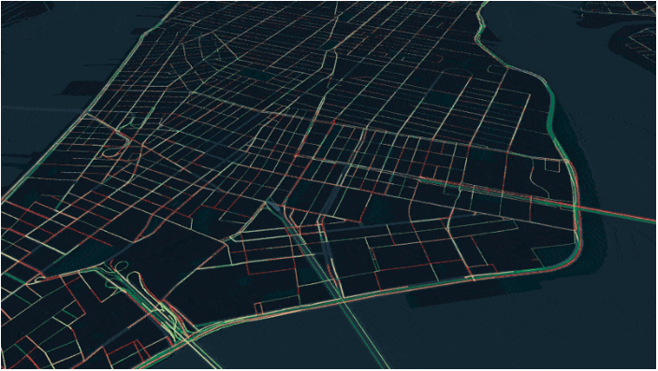
Graph data are everywhere
Social network
Protein/Molecule structure
Knowledge graph
Recommender Systems
Traffic Forecasting / Urban planning

Slide 4
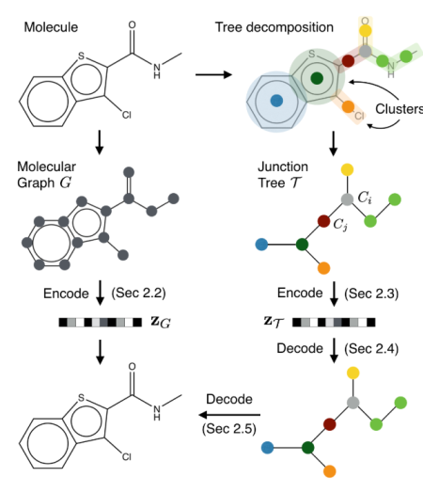
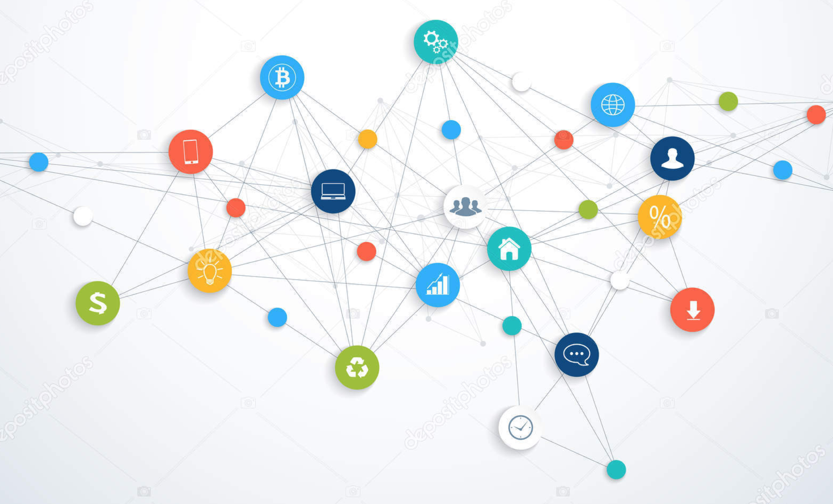
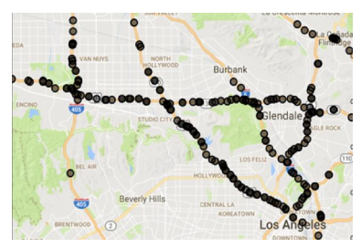
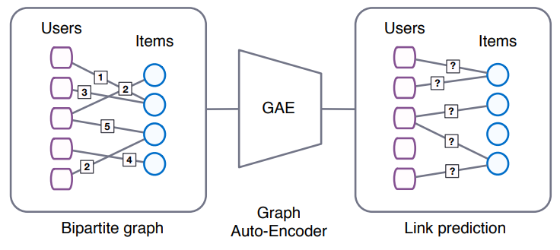
Many ML tasks learn from graphs
[Chen et al. arxiv’18]
[Schlichtkrull et al. arxiv’17]
[Jin et al. ICML’18]
[van den Berg et al., arxiv’17]
[Li et al., ICML’18]

Slide 5
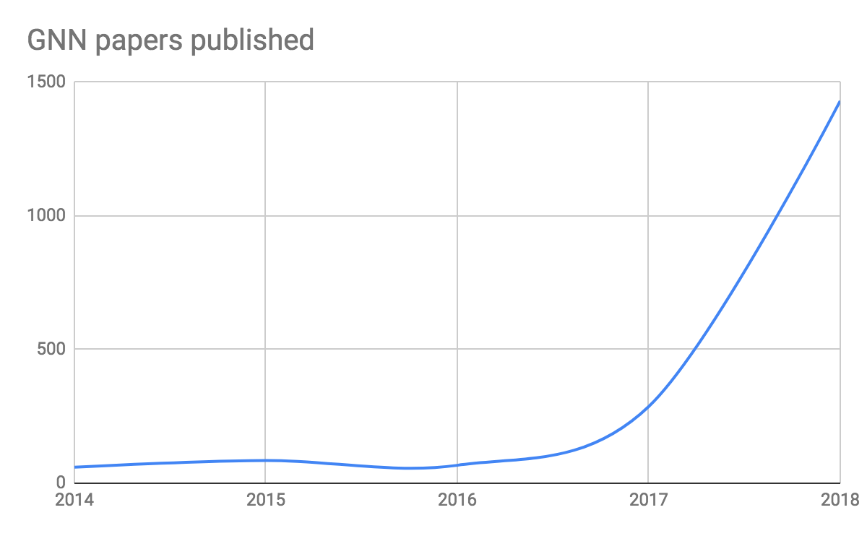
Deep learning + Graph => GNN
Graph Neural Network (GNN) is emerging as an important class of DL models.

Slide 6
What is GNN?
CNN: learn embedding of an image
cat
CNN
Classifier
dog

Slide 7
What does GNN do?
Graph Neural Network (GNN): learn embedding on nodes/edges/graphs
GNN
Classifier

Slide 8
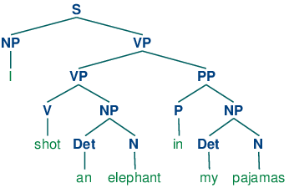
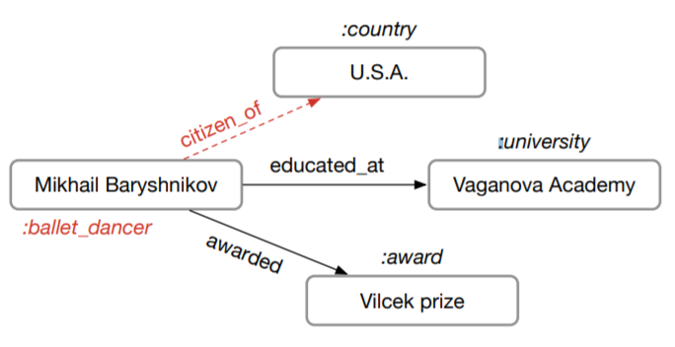
Existing implementations are often slow
Sentence Parse Tree
[Tai et al. ACL’15]
Molecule Graph
[Jin et al. ICML’18]
Knowledge Base
[Schlichtkrull et al. arxiv’17]
Training speed of one popular PyTorch version is only 23 trees/s
Author’s code in PyTorch: 8.25 graphs/s
Cannot run on GPU
due to OOM

Slide 9
Existing tools do not support GNNs well
Writing GNNs is hard in TensorFlow/Pytorch/MXNet.
(Our implementation) caused OOM … which is the reason for the lack of results on Pubmed.
-- from the authors of Graph Attention Network [ICLR’18]

Slide 10
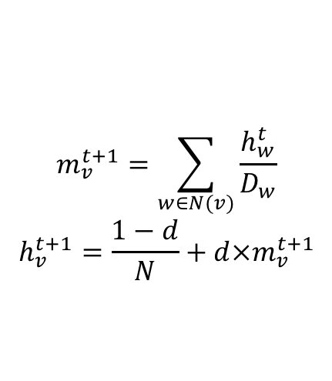
PageRank
PageRank computes the importance of pages.
$$m_{v}^{t+1}=\sum_{w∈N(v)}{\frac{h_{w}^{t}}{D_{w}}}$$
$$h_{v}^{t+1}=\frac{1−d}{N}+d×m_{v}^{t+1}$$

Slide 11
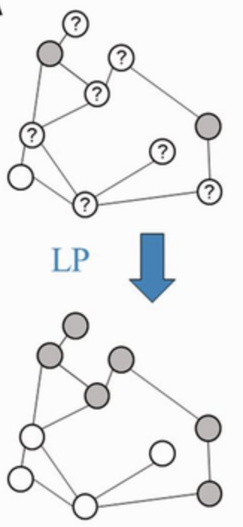
Label propagation
Label propagation can be used for connected components.

Slide 12
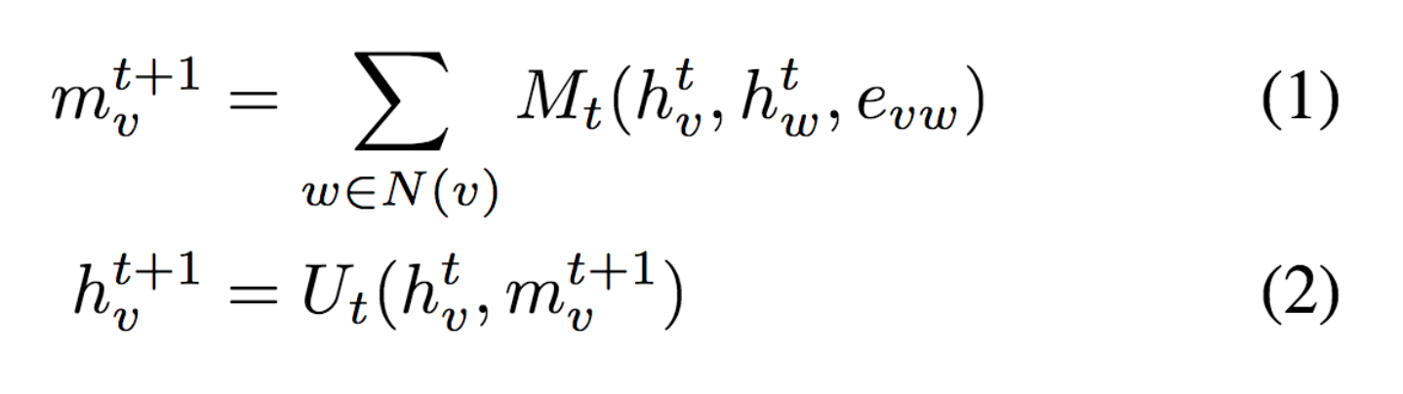

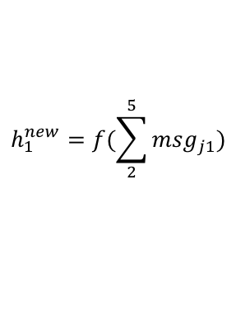
How does GNN do its job?
GNN is based on message passing
Reduce
Message
h₅
h₂
v₅
v₂
$${msg}_{51}^{}=h_{5}$$
v₁
$$h_{1}^{new}=f(\sum_{2}^{5}{{msg}_{j1}})$$
Neural Message Passing for Quantum Chemistry
v₃
v₄
h₄
h₃
Notes:
Message: tensor computed from source node/ destination node/ edge features
Reduce: aggregating the messages (and updating the node representation accordingly)

Slide 13
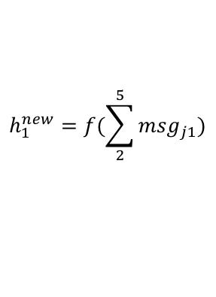
Why is programming GNN hard?
GNN is based on message passing
Tensorflow/Pytorch/MXNet provides tensor programming
h₅
h₂
v₅
v₂
$${msg}_{51}^{}=h_{5}$$
v₁
$$h_{1}^{new}=f(\sum_{2}^{5}{{msg}_{j1}})$$
v₃
v₄
h₄
h₃
How tensors are transformed
On edge: how messages are calculated
On node: how messages are aggregated and consumed

Slide 14
Goals of DGL
Forward and backward compatibility
Fast and Scalable

Slide 15
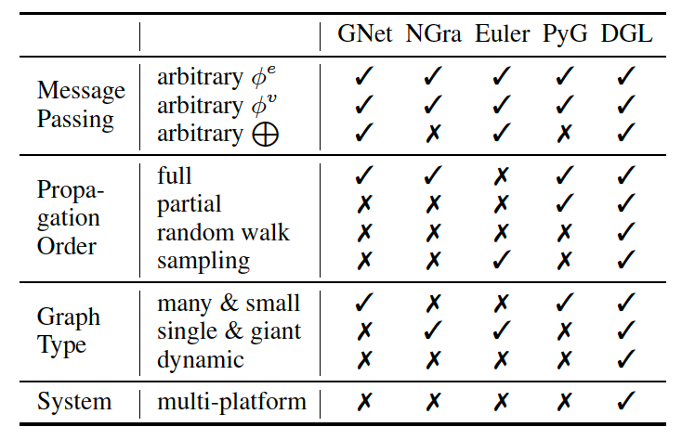
Forward compatibility
Facilitate as many models with graph structures as possible
With a very narrow and intuitive APIs that provide
Flexible message propagation control
Concise set of builtin message/reduce functions
Arbitrary user-defined functions (UDFs) support

Slide 16
Flexibility of Message Passing Control
3
3
3
3
1
2
1
2
1
2
1
2
4
4
4
4
A graph
send/rcv of a pair
Parallel send/rcv of all pairs
send/rcv of a trajectory
Different levels of controls
Level-1: send, recv
Level-2: send_and_recv, pull, push, update_all
Level-3: propagate

Slide 17
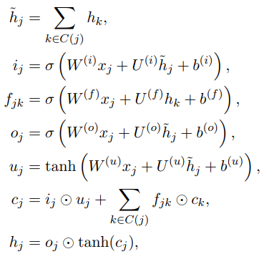
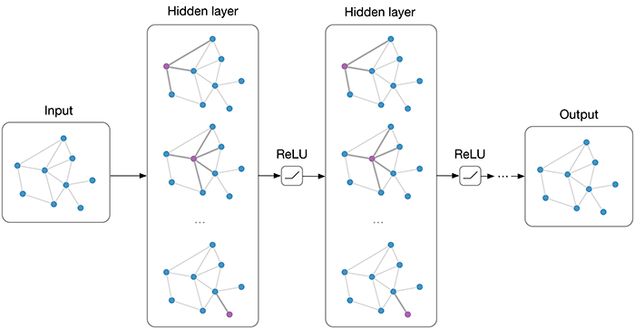
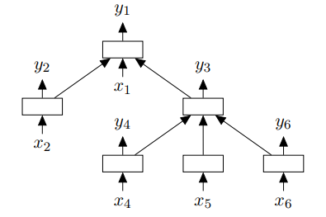
Flexibility of Message Passing Control
GNN: update all in parallel
Tree-LSTM: update with order

Slide 18
Flexibility of Message Passing Control
Message functions, examples:
Copy feature from source node (copy_src/copy_u)
Multiply source node feature with edge feature (u_mul_e)
…
Reduce functions
Sum/Max/Min/Prod/…
Notes:
Multiply can be replaced with other binary operations as well.
The operands can also change to source, destination or edge

Slide 19
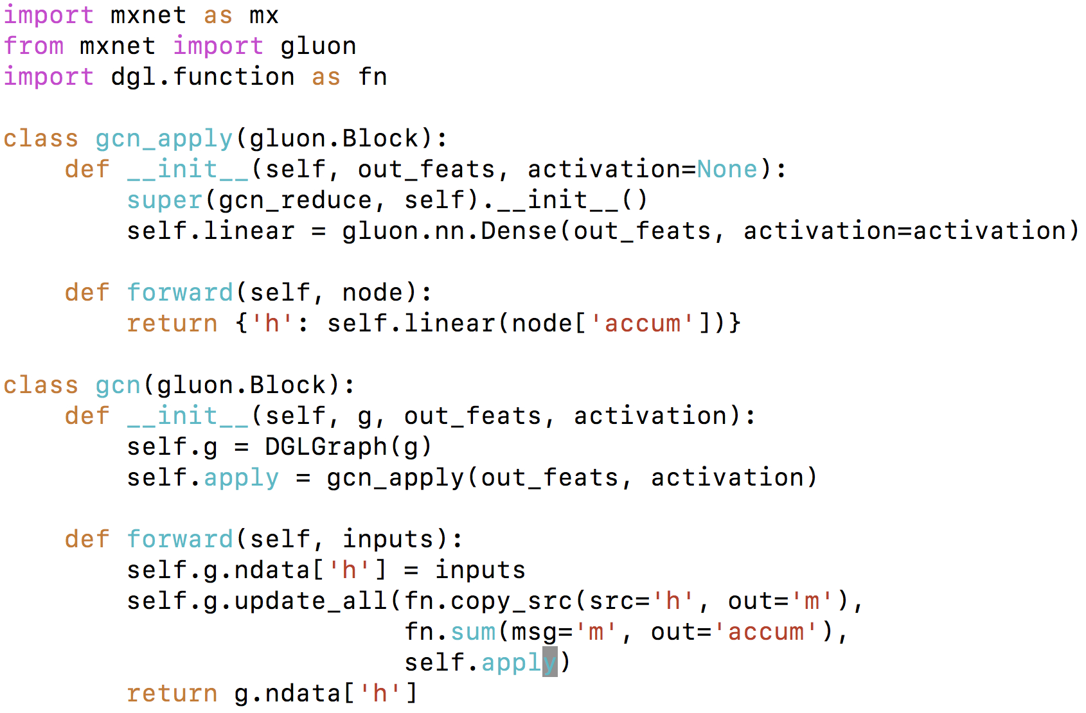
DGL code example: GCN using builtins
Use DGL built-in message and reduce functions
Notes:
… which we will explain in greater detail in the next session.
Here’s an overview of how the code of GCN would look like.

Slide 20
User defines functions (on batches of nodes/edges)
u
v
<message>: edge
u.data[‘h’]
(e.src.data[‘h’])
e.data[‘h_e’]
v.data[‘h’]
(e.dst.data[‘h’]
<reduce>: node
v.mailbox[‘m’]
Message function
(edges) -> msg
Reduce function
(nodes) -> new_node_feature
Auto-batched (tensorized)
As if writing for one node/edge
Notes:
… DGL also support Python message/reduce functions although less efficiently.
So try your best to use builtins, and fallback to UDFs only if you want SUPER FANCY COMPLICATED message/reduce functions.

Slide 21
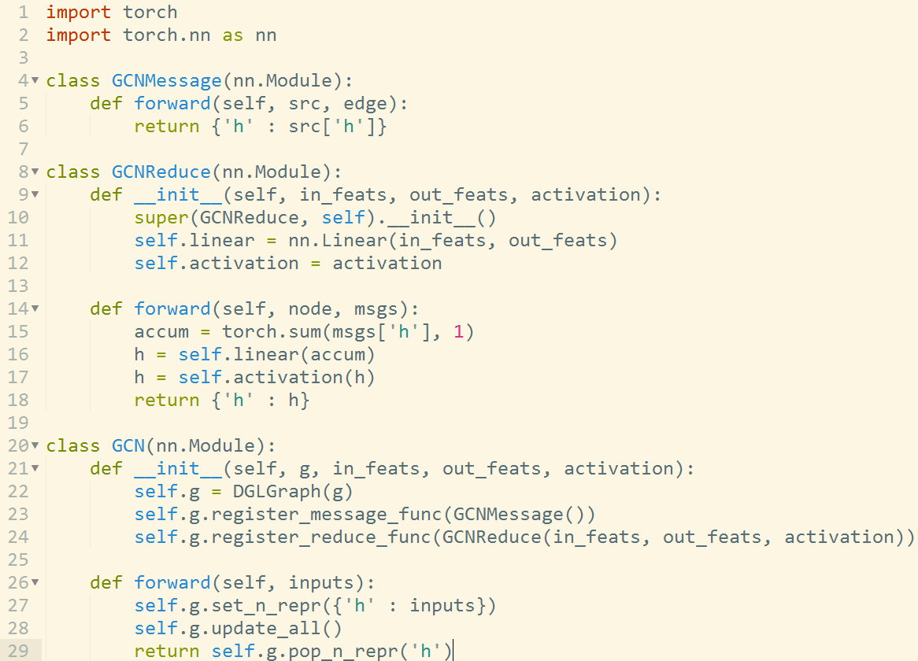
DGL code example: GCN
Tensor for a batch of features
shape=(B, D)
Tensor for a batch of messages
shape=(B, deg, D)
Trigger message and reduce functions for all nodes

Slide 22
Backward compatibility
Platform agnostic
Division of labor
Existing frameworks handle tensor and autograd ops
DGL owns graph storage and optimizes sparse ops
Allows end-to-end integration for platforms of your choice
DGL
Frameworks (TF, Pytorch, MXNet, Keras, …)
Compilers (TVM (Neo), ONNX)
GPU, FPGA, IP core, Arm…

Slide 23
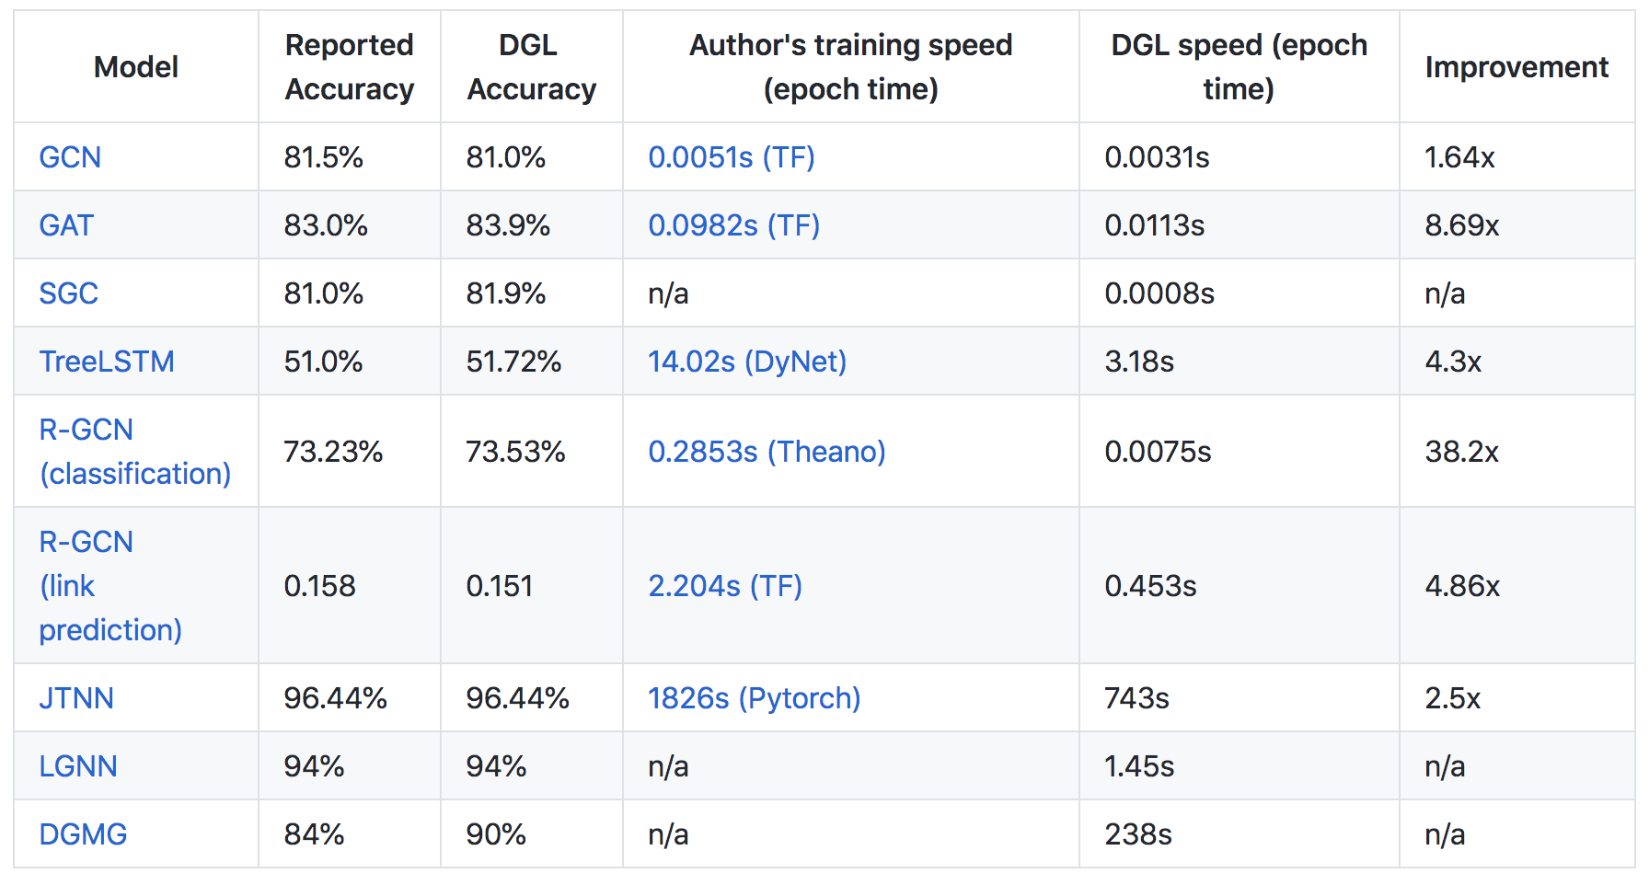
Is DGL Fast?

Slide 24
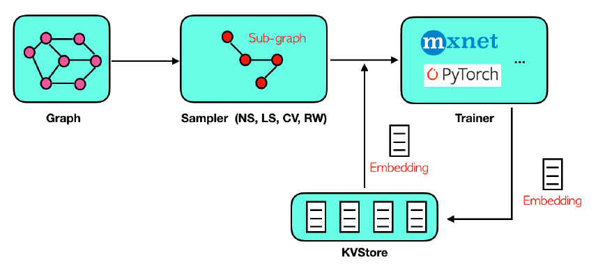
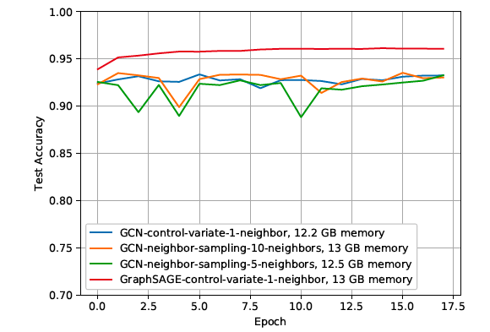
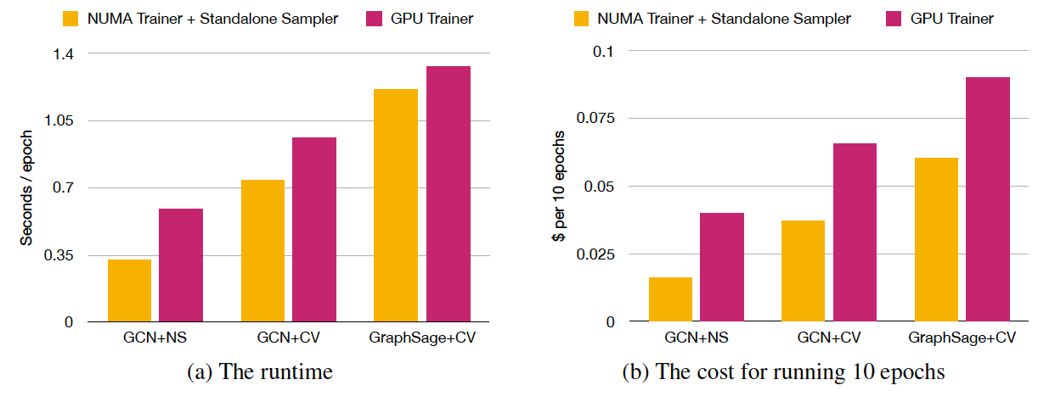
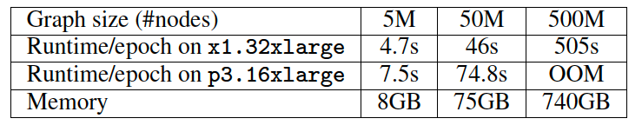
Is DGL scalable?
Notes:
We support up to half a billion nodes…..
We do that with neighbor sampling techniques
And with neighbor sampling and not-too-heavy feature computation, we found that CPU is more cost-effective than GPU

Slide 25
DGL’s offers
10+ off-the-shelf most popular GNN models (w/ detailed tutorials)
A central repo for 9 popular GNN datasets (cora, pubmed, …)
Easy development for advanced techniques:
Sampling for Large graphs
PinSAGE [WWW’18], [Jianfei et al., ICML’18], FastGCN [ICLR’18], …
Generating dynamic graphs
JTNN [ICML’18], DGMG [CVPR’18], …
Batch processing of multiple graphs
TreeLSTM [ACL’15], JTNN [ICML’18], …

Slide 26
DGL milestones
v0.1 12/18, v0.2 03/19, v0.3 06/19
~2300 stars, 300+ forks on github, 35K+ package downloads
Twitter followers 1K+, 30 contributors,
Two hands-on tutorials (NVIDIA GTC 2019, SIGKDD 2019), 10+ blog posts
Notes:
Typical release cycle is three months per major release.

Slide 27
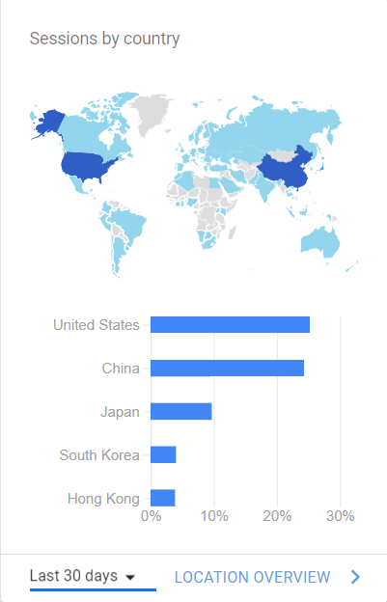
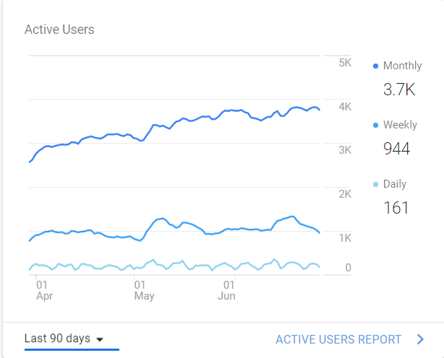
DGL adoption (around the world)

Slide 28
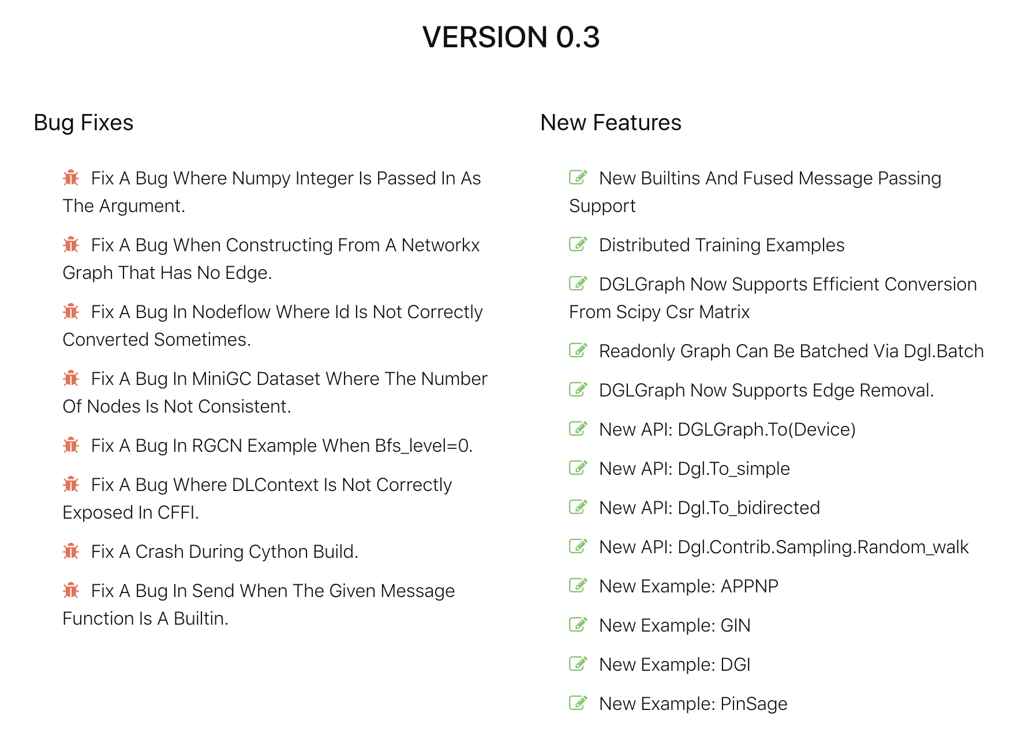
DGL v0.3 features, v0.4 planned

Slide 29
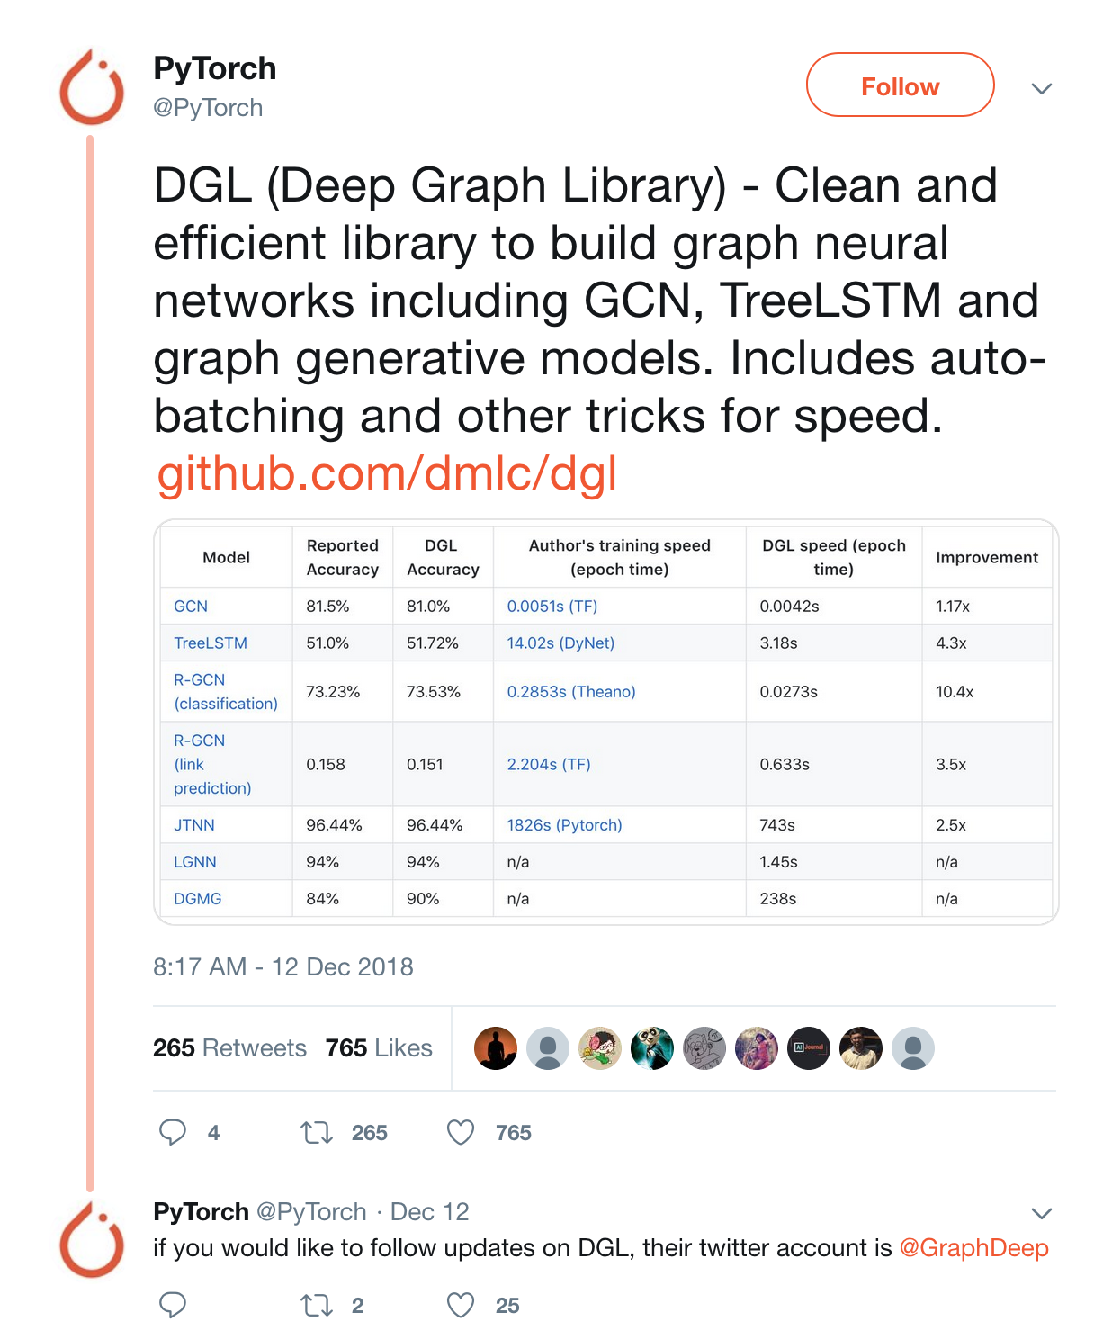
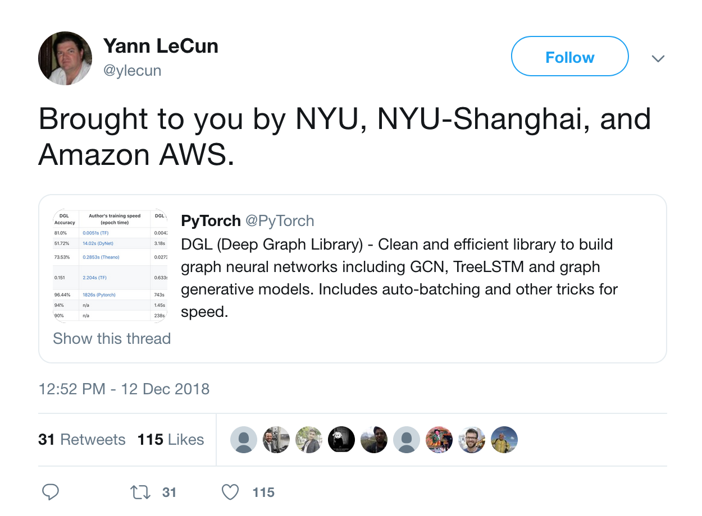
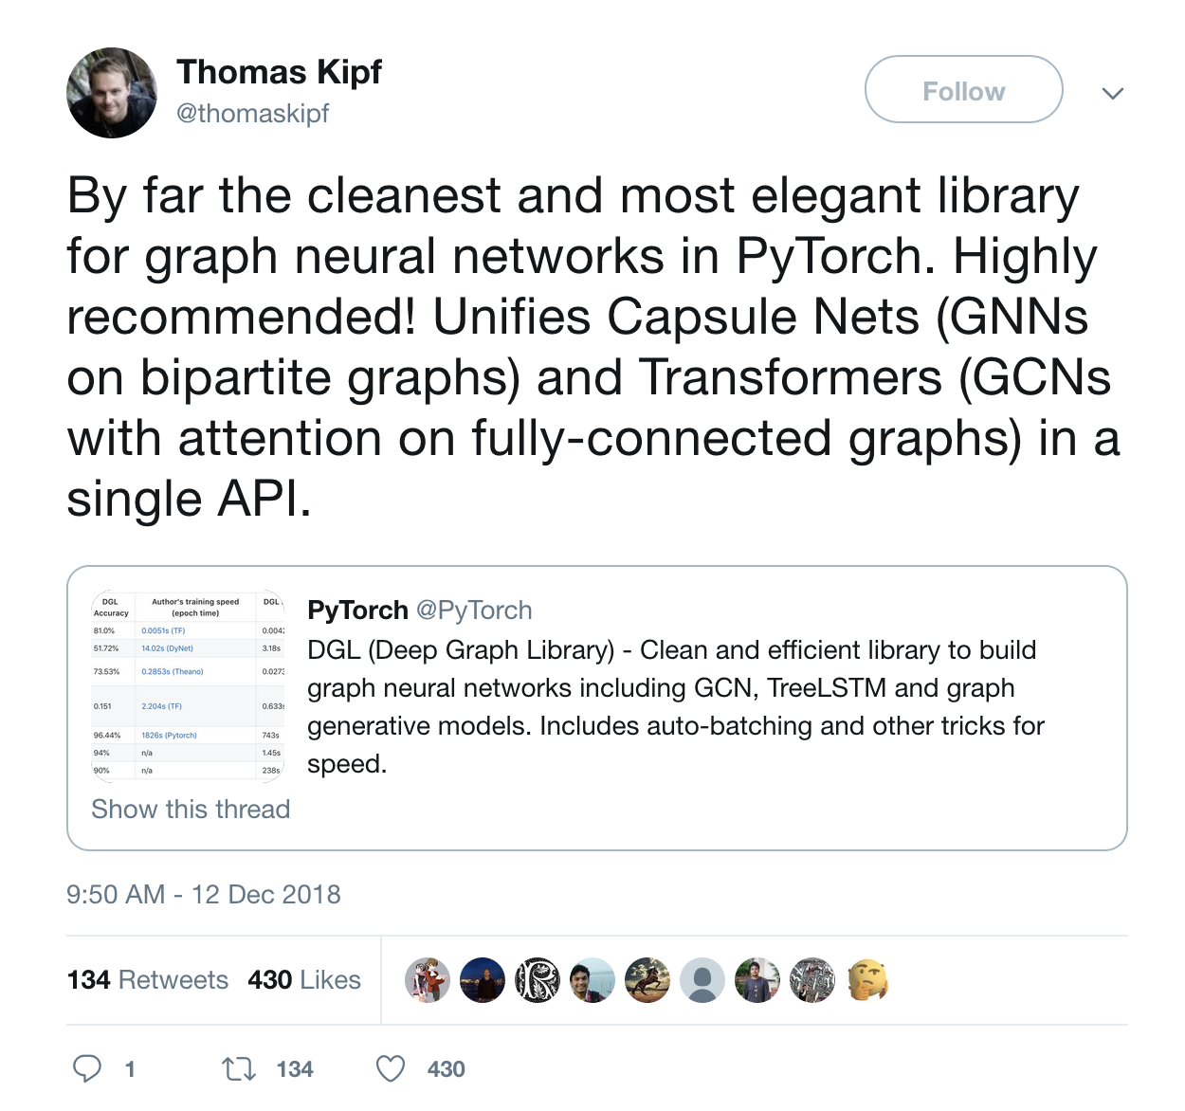
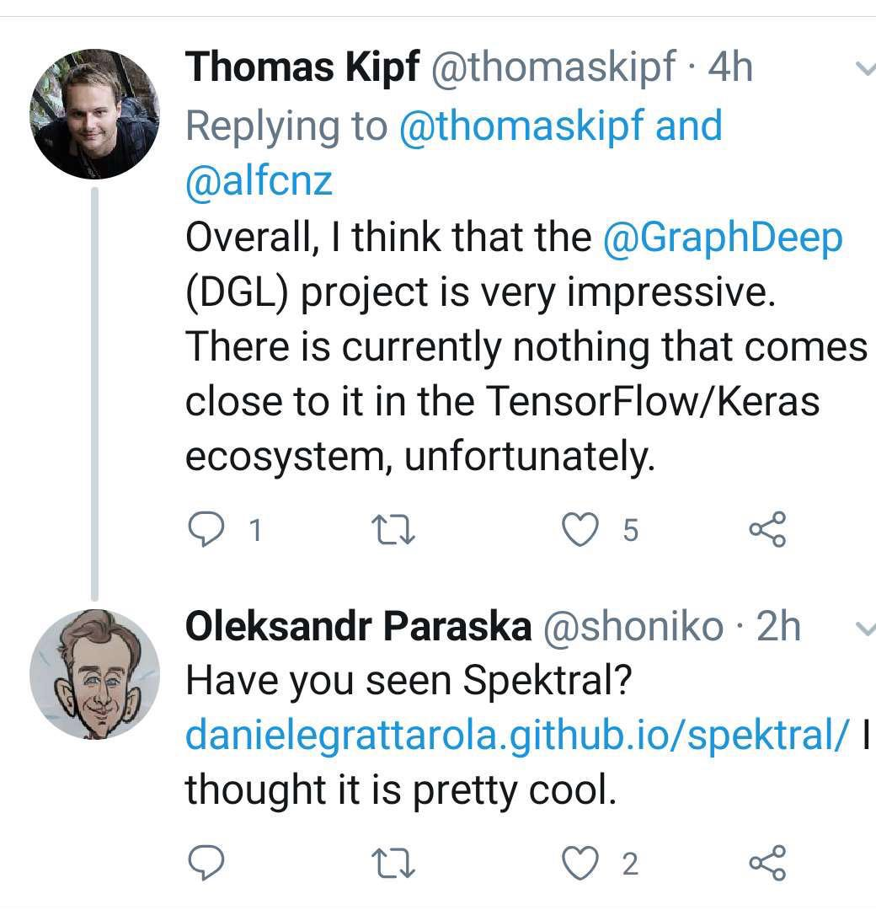

Slide 30
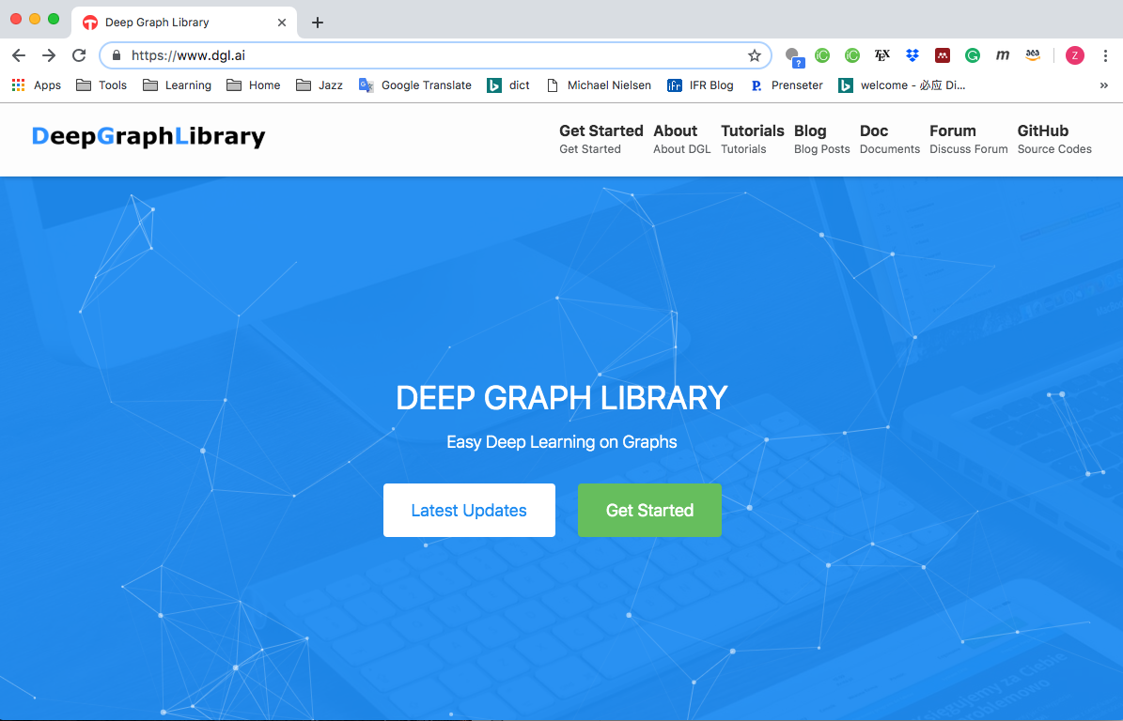
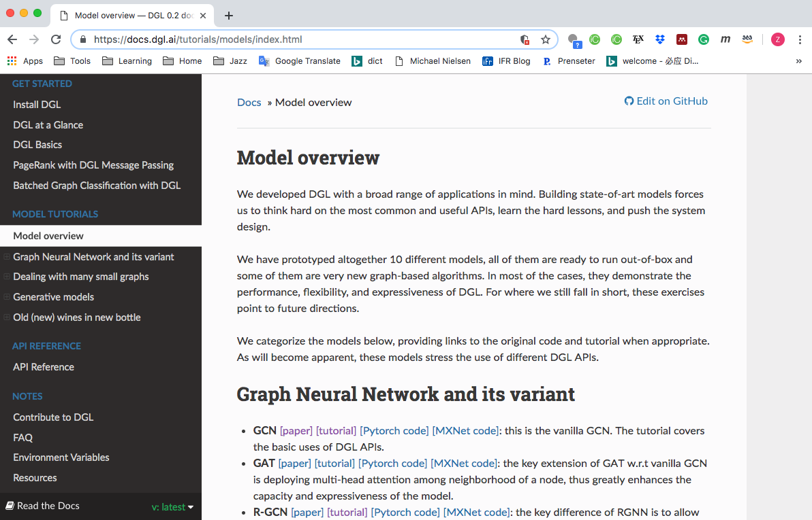
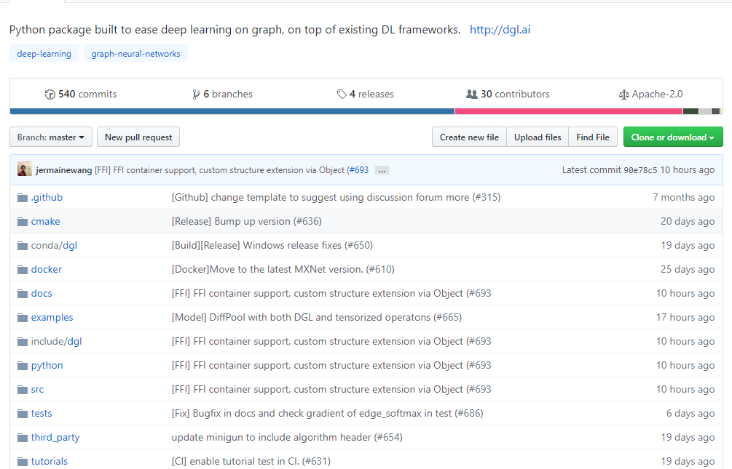

Slide 31
Resources
DGL website: http://dgl.ai/
DGL GitHub Repository: https://github.com/dmlc/dgl
DGL discuss forum: https://discuss.dgl.ai/
Please try it! And we hope to see your contributions!!

